Slide 1
WILLIAM SHAKESPEARE

Slide 2
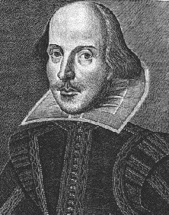

Slide 3
BIOGRAPHY
Shakespeare was an English poet, playwright and actor
His works consist of 37 plays, 154 sonnets, 2 long poems
He was born and brought up in Stratford-upon-Avon
At the age of 18 he married Anne Hathaway
They had 3 children Susanna and twins Hamnet and Judith

Slide 4
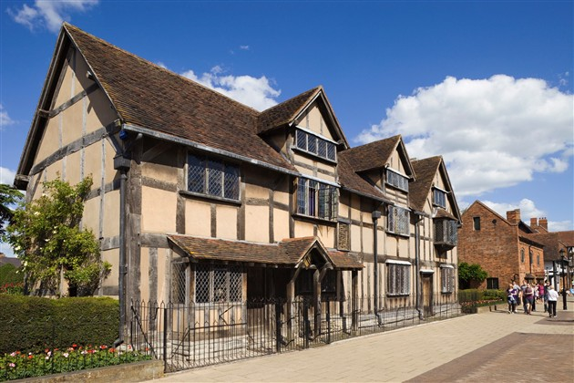

Slide 5
BIOGRAPHY
Between 1585 and 1592 he began his career in London as an actor
His plays were comedies, histories and tragedies
In his last phase he wrote romances
In 1599 a partnership of members of the company built their own theatre on the River Thames which they named The Globe

Slide 6
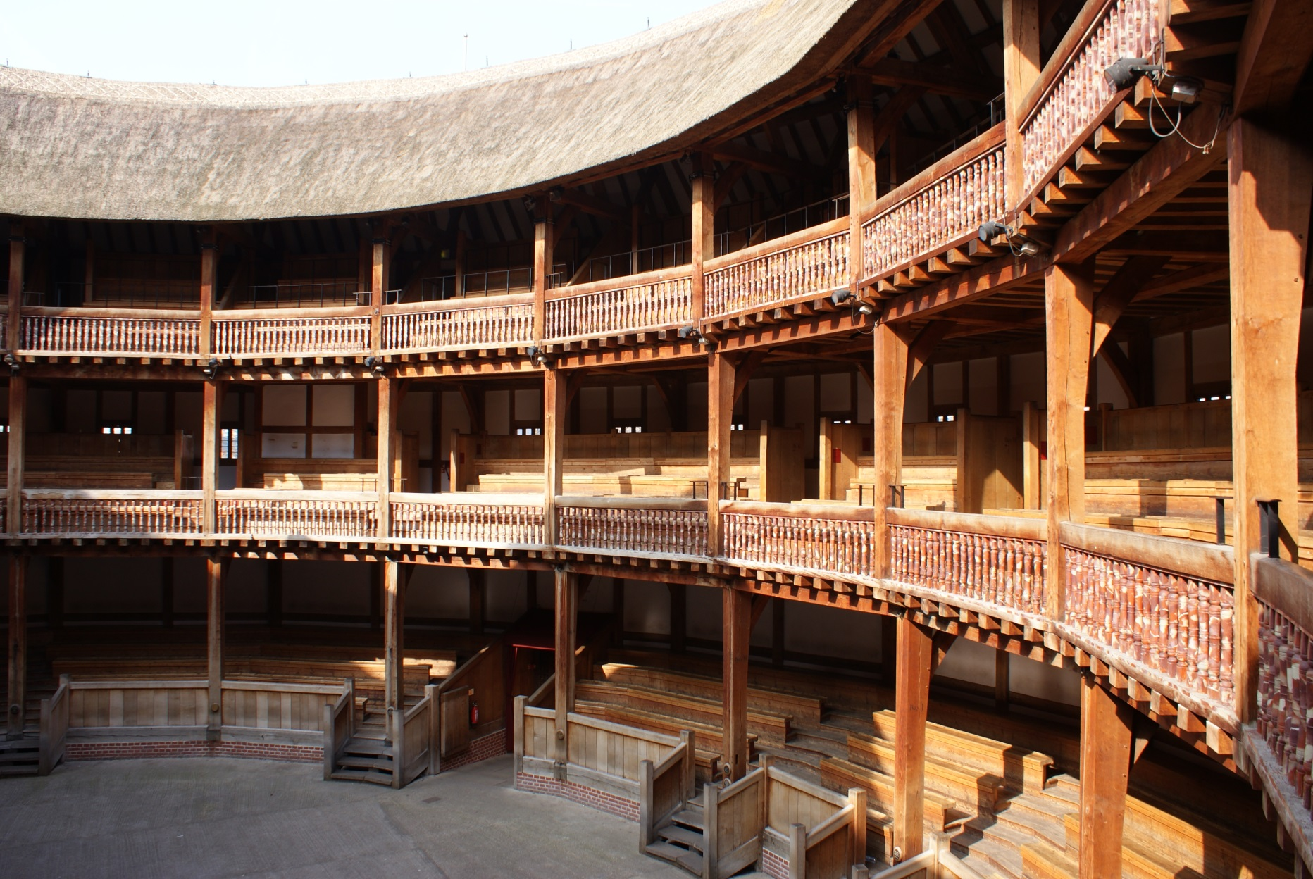

Slide 7
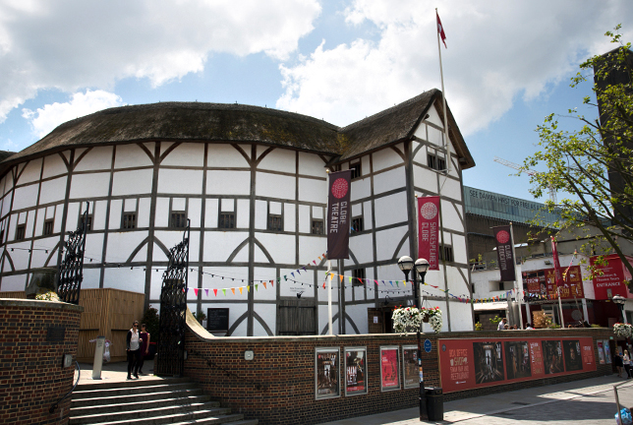

Slide 8
BIOGRAPHY
He has retired to Stratford around 1613 at the age of 49 where he died 3 years later
He died on 23 April 1616

Slide 9
RELIGION
Members of Shakespeare's family were Catholics, at the time, when practicing Catholicism in England was against the law.
He was a confirmed member of the Church of England, where he was married, his children were baptised, and where he is buried

Slide 10
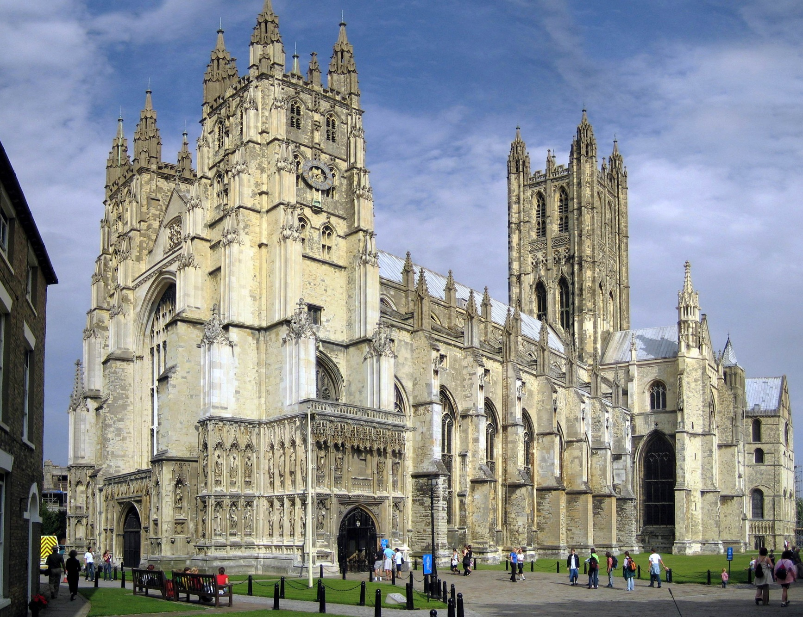

Slide 11
SEXUALITY
Few details of Shakespeare's sexuality are known.
At the age of 18, he married 26-year-old Anne Hathaway, who was pregnant.
Susanna, the first of their three children, was born six months later on 26 May 1583.
Over the centuries, some readers have posited that Shakespeare's sonnets are autobiographical, and point to them as evidence of his love towards a young man.

Slide 12
SEXUALITY
Others read the same passages as the expression of intense friendship rather than romantic love.
The 26 so-called "Dark Lady" sonnets, addressed to a married woman, are taken as evidence of heterosexual liaisons.

Slide 13
SHAKESPEARE’S TRAGEDIES
Romeo and Giuliett (Romeo i Julija)
Titus Andronicus (Tit Andronik)
Julije Cezar
Troilus and Cressida (Troilo i Kresida)
Hamlet
Othelo
King Lear (Kralj Lear )
Macbeth
Antony and Cleopatra
Koriolan
Timon Atenjanin

Slide 14
SHAKESPEARE’S COMEDIES
Love's Labour's Lost (Uzaludni ljubavni trud)
The Two Gentlmen of Verona (Dva plemića iz Verone)
The Comedy of Errors (Komedija nesporazuma)
A Midsummer Night's Dream (San ljetne noći)
The Merchant of Venice (Mletački trgovac)
The Taming of the Shrew (Ukroćena goropadnica)
The Merry Wives of Windsor (Vesele žene vindsorske)

Slide 15
SHAKESPEARE’S COMEDIES
Twelfth Night (Bogojavljenska noć ili Na tri kralja)
Much Ado About Nothing (Mnogo vike ni za što)
As You Like It (Kako vam drago)
All's Well That Ends Well (Sve je dobro što se dobro svrši)
Measure for measure (Ravnom mjerom /Mjera za mjeru)
Periclo

Slide 16
SHAKESPEARE’S COMEDIES
Cymbeline (Cimbelin)
Winter story (Zimska priča)
The tempest (Oluja/Bura)

Slide 17
SHAKESPEARE’S HISTORIES
King Henrik VI
King Richard III
King Richard II
King John
King Henrik IV
King Henrik V
King Henrik VIII

Slide 18
SHAKESPEARE’S SONNETS
Venus and Adonis (Venera i Adonis)
The Rape of Lucrece (Napastovanje Lukrecije)
The Passionate Pilgrim (Strastveni hodočasnik)

Slide 19
INTERESTING FACTS
After the England’s Royal family, Westminister Abbey, Big Ben and red double decker buses, William Shakespeare is one of the most famous icons of England
His plays are being performed all over the world stages for the past 400 years
He led a life as a famous playwright in London and in Stratford he was businessman and property owner

Slide 20
INTERESTING FACTS
He is often called ”Bard of Avon”
From few orginal signatures we come to know that Shakespeare spelt his name:
Willm Shaksp
William Shakespe
Wm Shakspe
William Shakspere

Slide 21
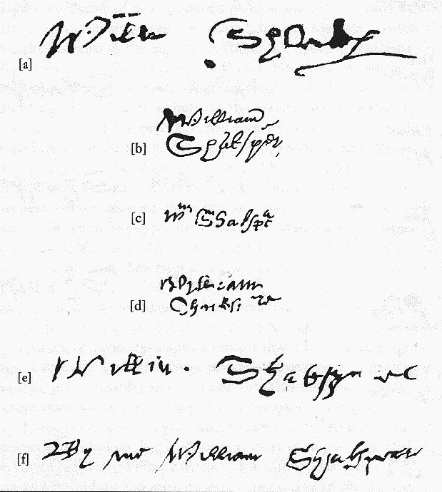

Slide 22
INTERESTING FACTS
Between 1585 and 1592 nobody knows where he was or what he was up to. These are known as his ”lost years”
He has lived through the Black Death-epidemic of plague
Shakespeare died a wealthy man and left his entire property to his daughter, Susanna
His wife Anne got the second best bed in his home

Slide 23
INTERESTING FACTS
Suicide deaths occurred in Shakespeare plays an unlucky 13 times
He never published any of his plays
The women’s roles were performed by young men
He wrote around 37 plays in his lifetime, at least two of his plays were lost
No portraits of Shakespeare were painted during his lifetime, there are only two authentic portraits

Slide 24
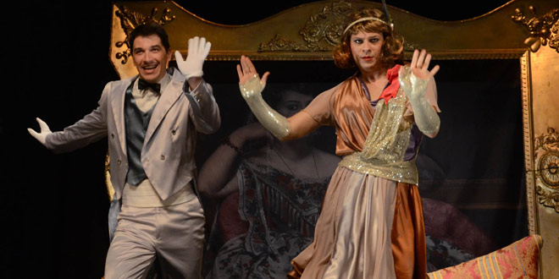

Slide 25
INTERESTING FACTS
The moons of Uranus were named after characters in Sakespeare’s plays but not even a star has been named after writer himself
Plays were performed only in the afternoon, by daylight
His exact birthdate is unknown
He didn’t go to college

Slide 26
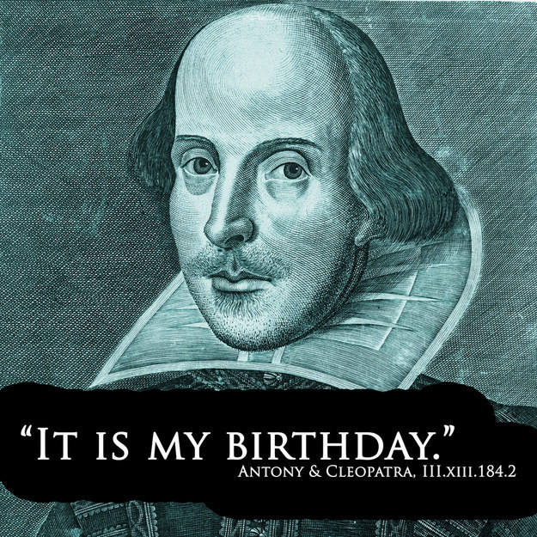

Slide 27
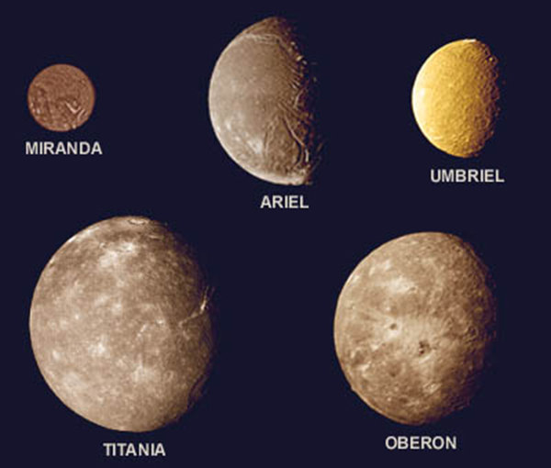

Slide 28
IZRADILE:
Mihaela Sušec i Elena Banovec
8.C

