Slide 1
william shakespeare

Slide 2
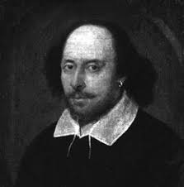
biography
William Shakespeare was born on 26th April 1564
he was an English playwright and an actor, widely regarded as the greatest writer in the English language and the world's pre-eminent dramatist
often referred to as England's national poet

Slide 3
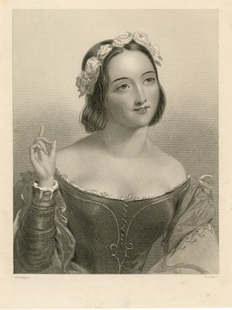
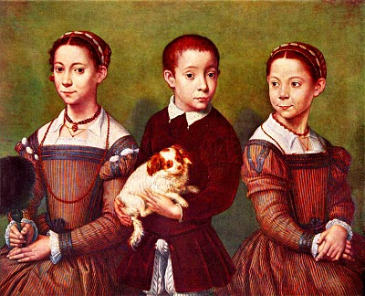
he lived in London with his family
he had a wife Anne who he married when she was twenty-six and hi was only eighteen
they had three children:
Susanna, and twins
Hamnet and Judith
he was an
actor, writer, and a
part-owner
of a playing company

Slide 4
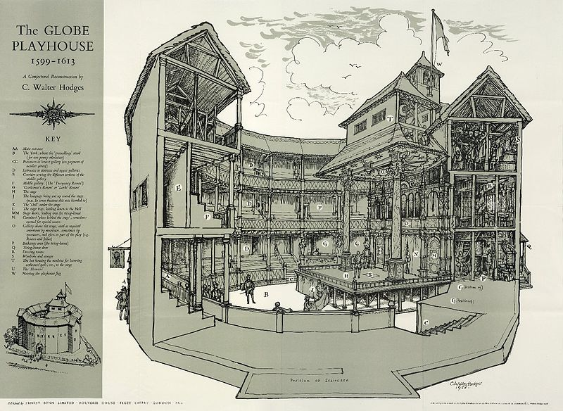
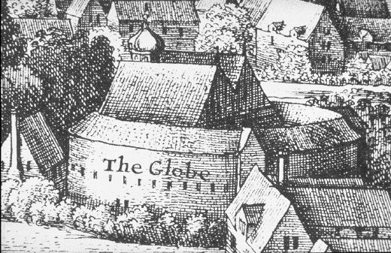
Globe theathre
The Globe Theatre was a theatre in London associated with William Shakespeare.
It was built in 1599 by Shakespeare's playing company and was destroyed in fire on 29 June 1613. A second Globe Theatre was built on the same site by June 1614 and closed in 1642.

Slide 5
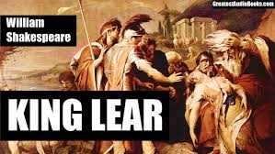
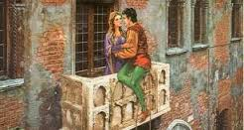
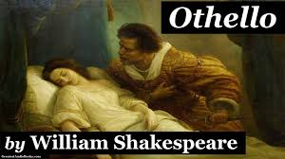
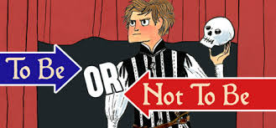
Tragedy
Hamlet (1602.)
Othello(1604.)
King Lear (1605.)
Romeo and Juliet (1593.)

Slide 6
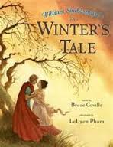
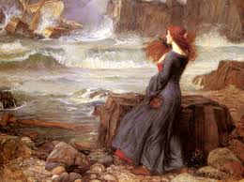
Comedy
The Tempest (1611.)
The Two Noble Kinsmen (1634.)
As You Like It (1600.)
The Winter's Tale (1610.)

Slide 7
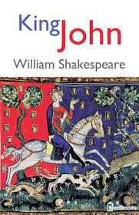
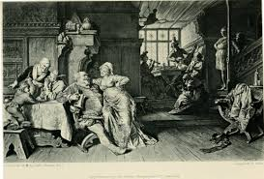
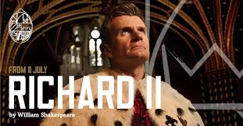
Historical Plays
Richard II and III (1593.)
King John (1594.)
Henry IV,V,VI and VIII (1599.)

Slide 8
Poems
Venus and Adonis (1593.)
The Rape of Lucrece (1594.)
The Passionate Pilgrim( 1599.)
Shakespeare's Sonnets (1609.)

Slide 9
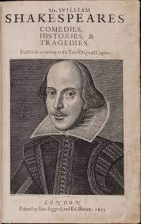
Shakespeare´s Opus
he wrote 34 plays, 154 sonnets
and several poems
divided into several categories :
early
adulthood
later period of time of creation

Slide 10
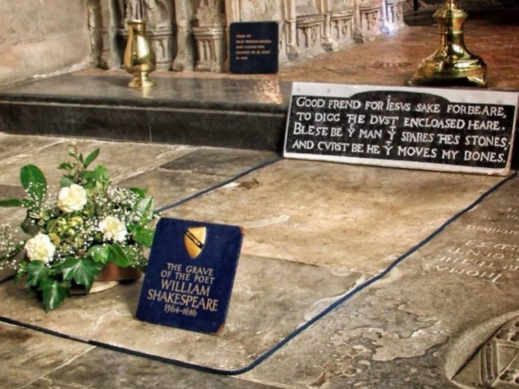
Death
he died on 23rd April
1616 in Stratford-upon-Avon,
United Kingdom
he was buried at st. Trinity
Church near the altar

Slide 11
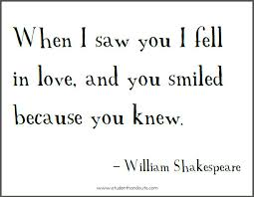
Quotes

Slide 12
Made by:
Laura Kostić
&
Ivana Mrvčić 8.^{b}

