Slide 1
WILLIAM SHAKESPEARE
About William from his birth

Slide 2
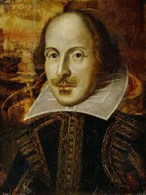
• William was born
on April 23, 1564
•He was born in
Stratford-upon-Avon,
United Kingdom.
•He was educated
in Kings New School.
•He was third child
in the family

Slide 3
He had two older sisters
William Shakespeare married Anne Hathaway on November 28, 1582, in Worcester, in Canterbury Province.
When William got married he was 18,and Anne was 26.

Slide 4
On February 2,1585,twins Hamnet and Judith were born. Hamnet later died of unknown causes at the age of 11.
William has few nicknames like “Bard of Avon”
“Swan of Avon”
“The Bard”

Slide 5
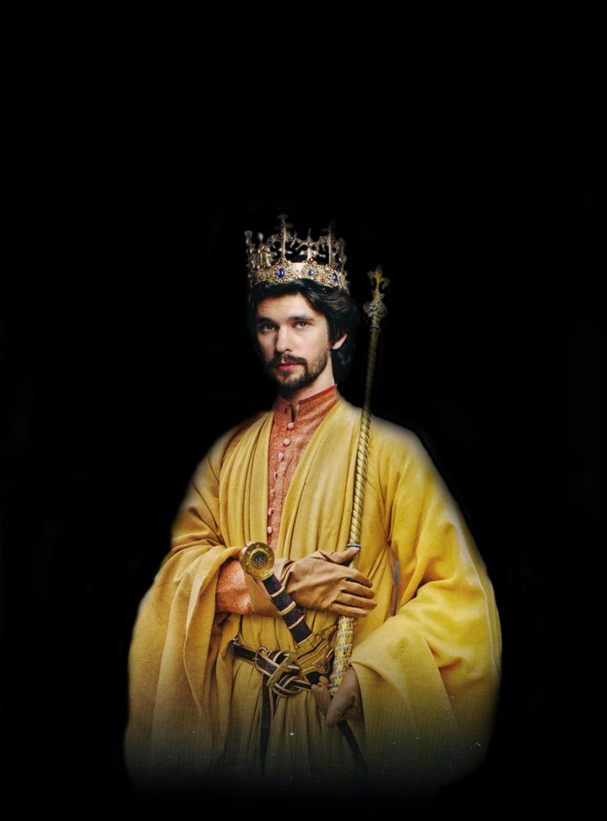
Example of his earlier works were(if we don’t count Romeo and Juliet) Richard II, Henry VI (parts 1, 2 and 3) and Henry V

Slide 6
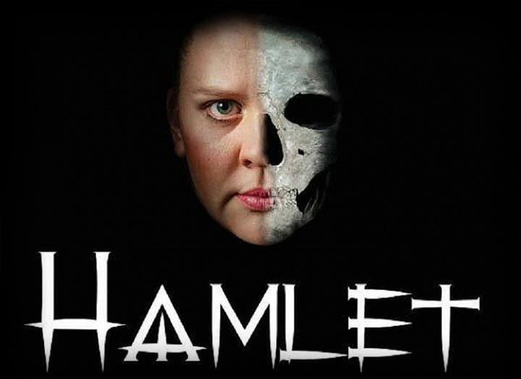
Hamlet
Hamlet is one of Shakespeare’s plays written between 1599 and 1602
Main character is Hamlet
The story takes
place in Denmark

Slide 7
What is Hamlet about?
When Hamlet’s father dies,Hamlet sees a ghost which wants a revenge on Hamlet’s uncle Claudius.
Hamlet finds out that his father was killed by Claudius
Famous saying from that play is:”To be or not to be?”

Slide 8
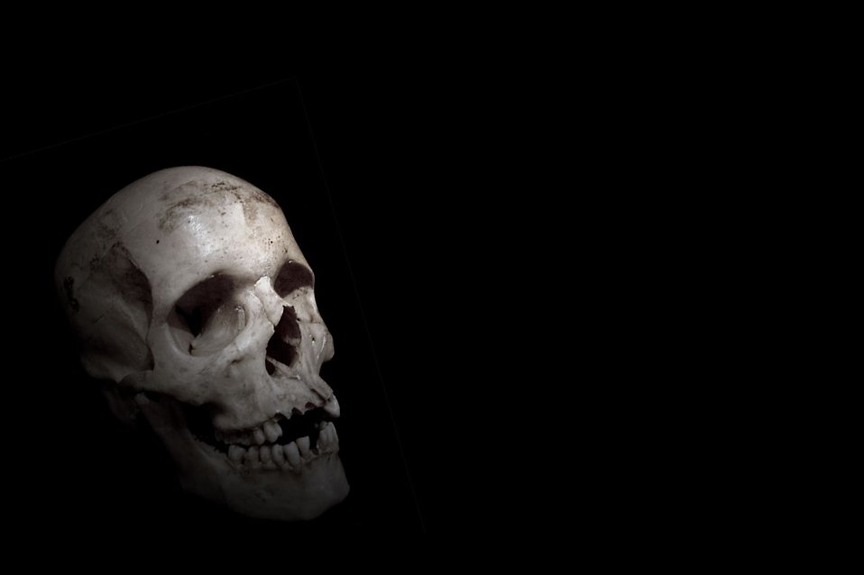
“ To be or not to be?”

Slide 9
Romeo and Juliet
Romeo and Juliet is a tragedy written in his early career
He wrote this tragedy sometime between 1591 and 1595

Slide 10
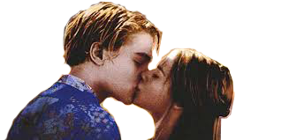
What is it Romeo and Juliet about?
A boy Romeo and a girl Juliet are in love but their parents are in a quarrel and they hate each other
So Romeo and Juliet are in secret love

Slide 12
By 1597, 15 of the 37 plays written by William Shakespeare were published
By 1599, William Shakespeare and his business partners built their own theatre on the south bank of the River Thames, which they called the Globe.

Slide 13
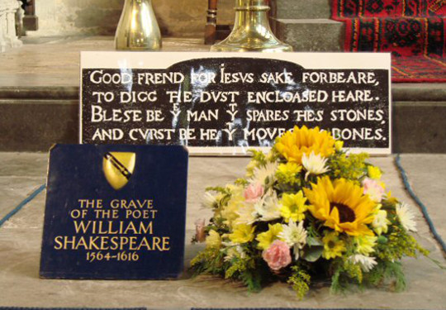
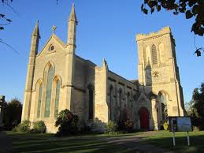
William died on his birthday 1616.

Slide 14
LUKAS ŠUŠNJAK 8.D

