Slide 1
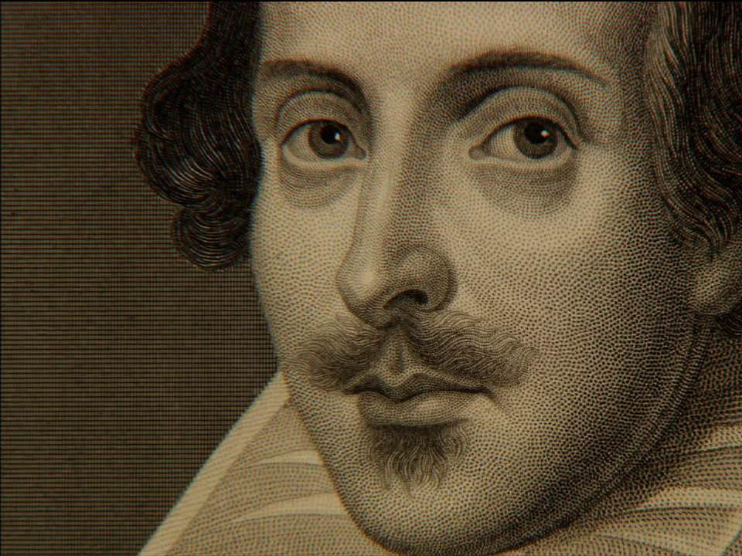
William Shakespeare

Slide 2
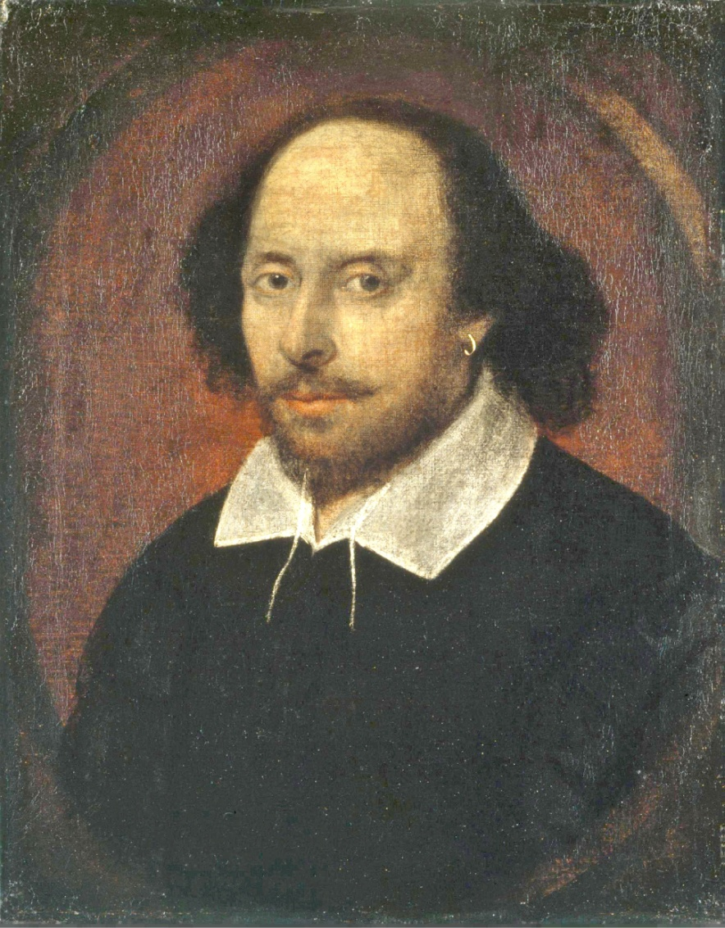
Who is he?
William Shakespeare was born on 26 April 1564
He was an English poet, playwright and actor
He is still one of the greatest writers of all time
He worked in the famous English Globe Theatre in that time

Slide 3
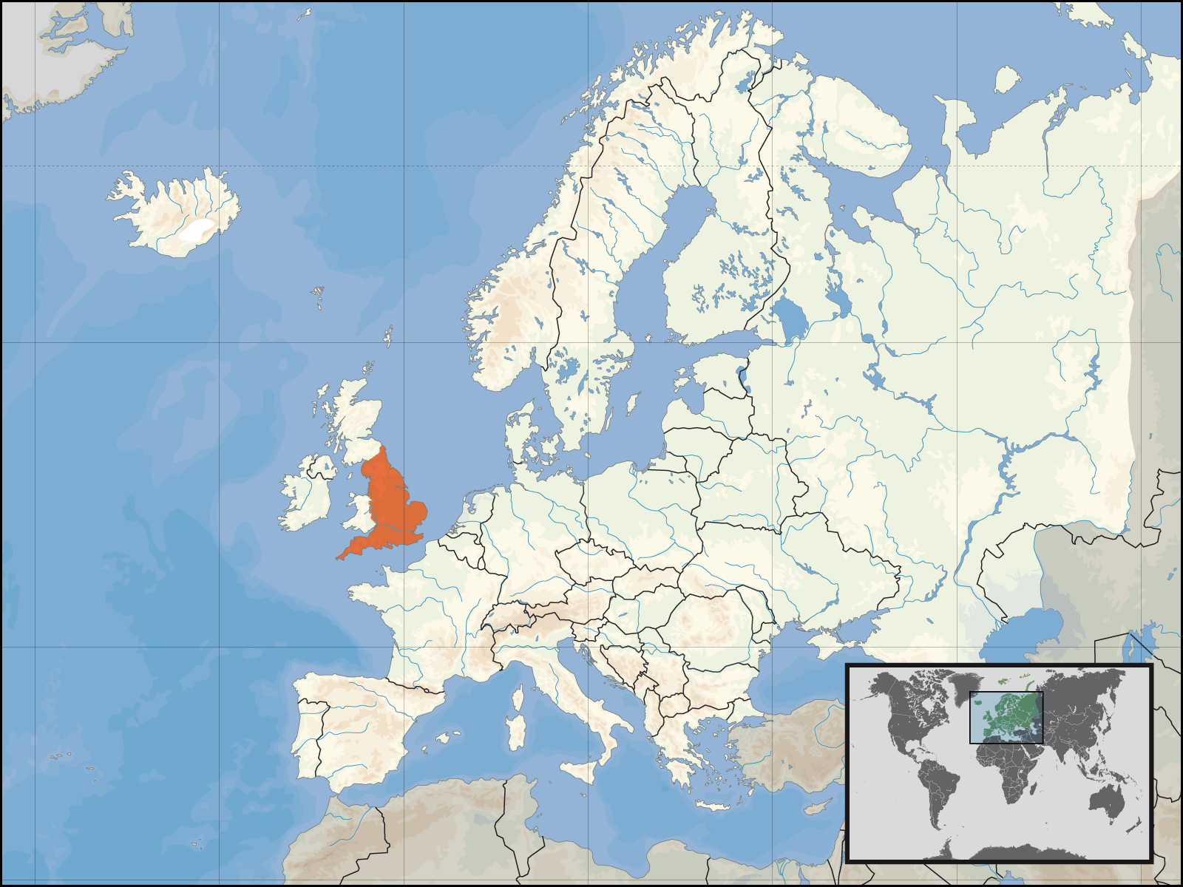
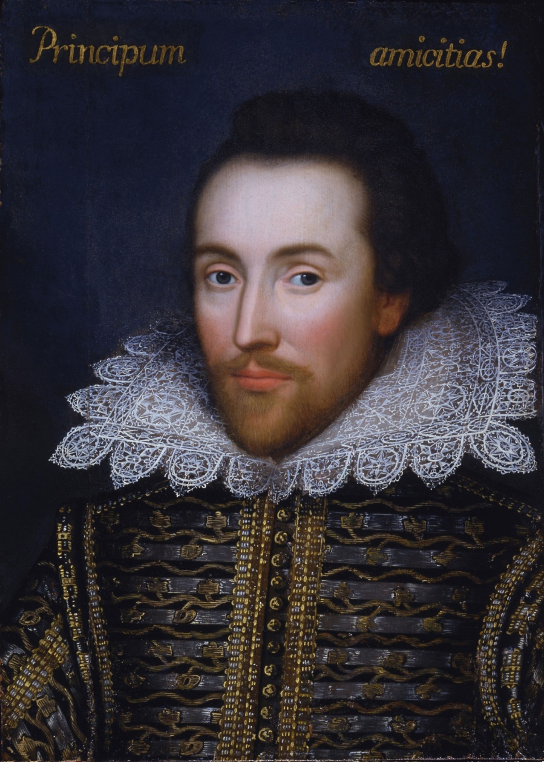
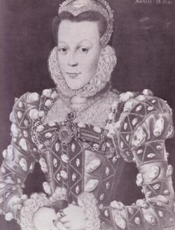
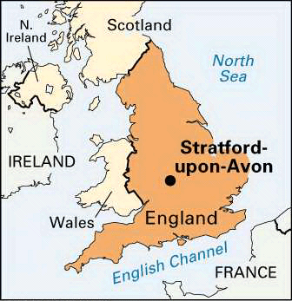
Early life
He was born in Stratford-upon-Avon
Shakespeare was probably educated at the King's New School in Stratford, a free school chartered in 1553.
His parents were John Shakespeare from Snitterfield, and Mary Arden whose father was a farmer
John Shakespeare Mary Arden

Slide 4
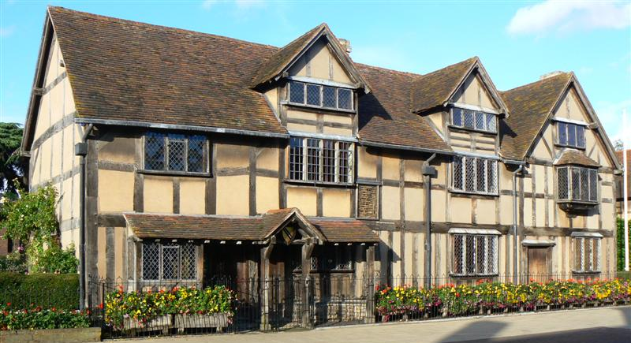

Slide 5
Creativity
He wrote about 34 dramas, 154 sonets and a few poems
His “creativity” is separated in three parts:
1. early dramas (comedy and history)
2. mature age (big tragedy)
3. later age of creativity (comedy and romance)
He is concidered to be one of the best drama writers not just in England and Europe but in the whole world

Slide 6
Tragedy History drama
Romeo and Juliet; 1593.
Titus Andronicus; 1594.
Julius Caesar; 1599.
Troilus and Cressida; 1601. - 1602.
Hamlet 1602.
Othello; 1604.
King Lear; 1605.
Macbeth 1606.
Antony and Cleopatra; 1607.
Coriolanus; 1608.
Timon of Athens; 1608.
Cymbeline; 1610.
Henry VI; 1591.
Richard III; 1593.
Richard II; 1594.
King John; 1594.
Henry IV; 1596. - 1597.
Henry V; 1599.
Henry VIII; 1612.

Slide 7
Comedy Poems
Love's Labour's Lost; 1590.
The Two Gentlemen of Verona; 1591.
The Comedy of Errors; 1593. - 1594.
A Midsummer Night's Dream; 1594.
The Merchant of Venice; 1595.
The Taming of the Shrew; 1596.
Much Ado About Nothing; 1599.
The Merry Wives of Windsor; 1599.
Twelfth Night, or What You Will; 1599. - 1600.
As You Like It; 1600.
All's Well That Ends Well; 1602. - 1604.
Measure for Measure; 1604.
Pericles, Prince of Tyre; 1608.
The Winter's Tale; 1610.
The Tempest; 1611.
Two Noble Kinsmen; 1634.
Venus and Adonis; 1593.
The Rape of Lucrece; 1594.
The Passionate Pilgrim; 1599.
The Phoenix and the Turtle; 1601.
A Lover's Complaint; 1609.
Shakespeare's Sonnets; 1609.

Slide 8
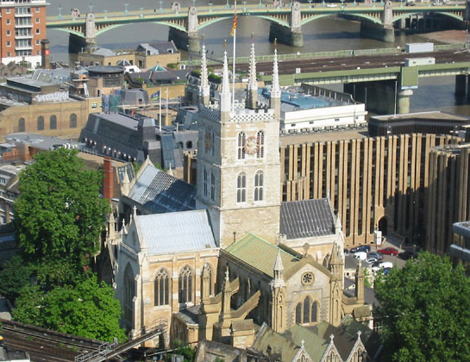
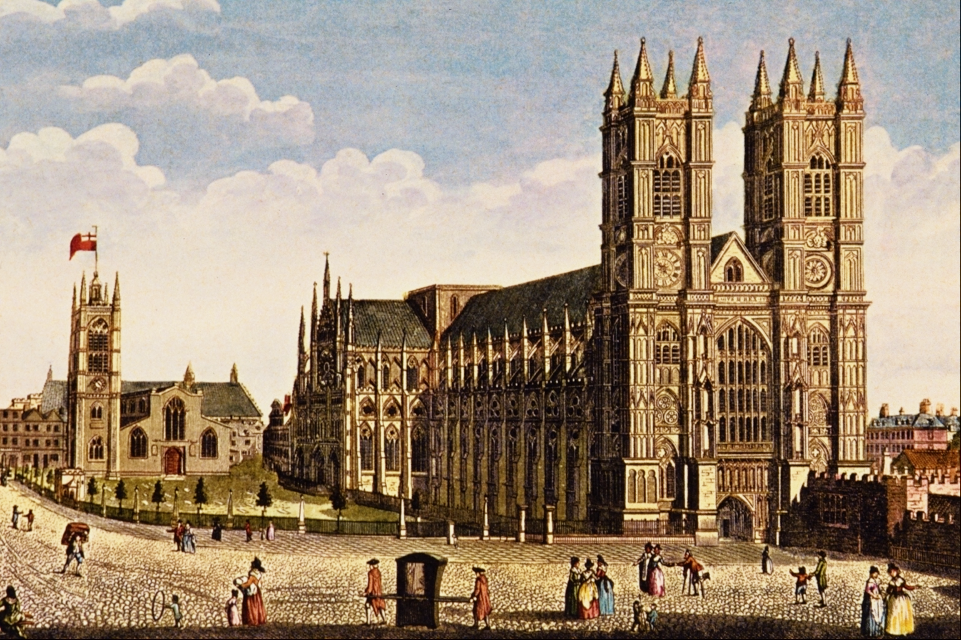
Death
23 April 1616 Stratford-upon-Avon, Warwickshire, England
Shakespeare has been commemorated in many statues and memorials around the world
Westminster Abbey
Southwark Cathedral

Slide 9
Interesting facts
One of Shakespeare’s relatives on his mother’s side, William Arden, was arrested for plotting against Queen Elizabeth I, imprisoned in the Tower of London and executed
Shakespeare married his wife Anne Hathaway when he was 18
The Comedy of Errors is Shakespeare’s shortest play, just 1,770 lines long
During his life Shakespeare performed in front of Queen Elizabeth I

Slide 10
Thanks for the attention!
Made by: Matej Košćec 8.b

