Slide 1
William Shakespeare
Made by Luka Feljak & Tomislav Kralj 8.c

Slide 2
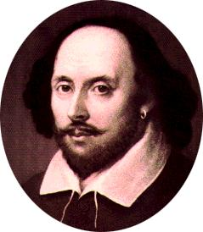
About Shakespeare
William Shakespeare was baptised on 26th April 1564 in Stratford-upon-Avon in England and we don’t know when he was born
He was English writer, theather actor and director
All his works were translated into all languages
He was a child from a count family Wackwickshire, he was the third oldest child

Slide 3
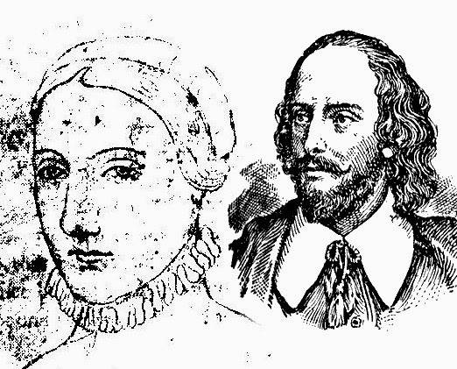
His father was John Shakespeare, polite and rich man
There are assumptions that he left school in 1578, because his father had problems with his job
Until his was 18 years old there were no written data about him, until 18th September 1582 there was only a data about his marrige with Anna Hathaway

Slide 4
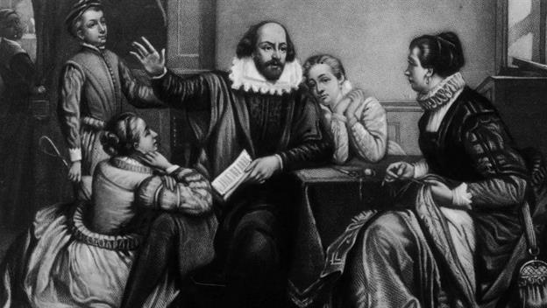
Shakespeare’s own family
Shakespeare’s wife was 8 years older than he was
William and Anna had three children which names were: twins, daughter Judith and son Hamnet (1585.) and his first daughter Susan (1583.)

Slide 5
His further life
In 1592 again nobody didn’t know where he went, but that year was the first time he was mentioned as a writer and an actor
In 1596 his son Hamnet dies,next year he buys property New Palace in Stratford
He become co-owner of the Globe Theatre
unfortunately his father died in 1601

Slide 6
In 1607 his daughter Susan got married to a famous London doctor John Hall
Year later his mother dies and after that tragic moment Shakespeare withdraws from London back to his home town
Sometimes he visited London and there is a proof because he was a witness in one lawsuit in 1612
Same year his brother Gilbert dies and next year his last brother Richard dies too
Aslo that year his Globe Theatre has been destroyed in a fire
And his last daughter Judith got married in 1616

Slide 7
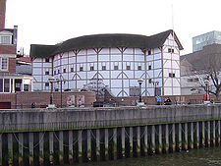
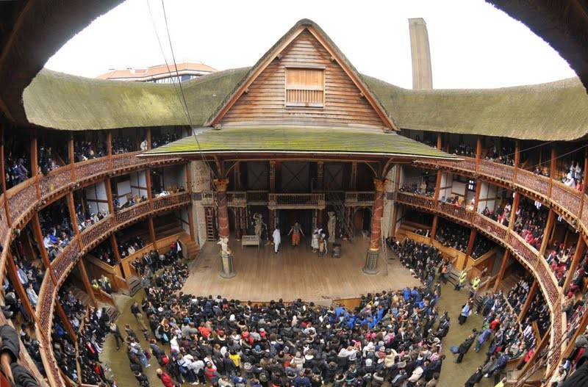
Globe Theatre
Outside
Inside

Slide 8
Shakespeare’s famous works
He wrote 10 historic dramas, 10 tragedies, 10 comedies, 4 novels, 3 drama ideas, 5 poems,154 sonnets and few short songs
Shakespeare signature:

Slide 9
COMEDY: The Comedy of Errors (1592/93)
The Taming of the Sbrew (1593/94)
The Two Gentlemen of Verona (1594/95)
TRAGEDY: Romeo and Juliet (1594/95)
Julius Caesar (1599/1600)
Hamlet (1600/01)

Slide 10
HISTORY: King John (1596/97)
Henry V. (1598/99)
Richard II. (1595/96)
POETRY: The Sonnets A Lover's Complaint The Rape of Lucrece

Slide 11
Shakespeare’s end
William Shakespeare died on 23rd April 1616 in Stratford
He was buried in Holy Trinity Church
On his grave was writen:
“IVDICIO PYLIUM, GENIO SOCRATEM, ARTE MARONEM. TERRA TEGIT, POPULUS MAERET, OLYMPUS HABET”
Translation: According to the wisdom of Nestor , the genius Socrates , the art of Virgil . The country covers , people crying , and Olympus has it.

Slide 12
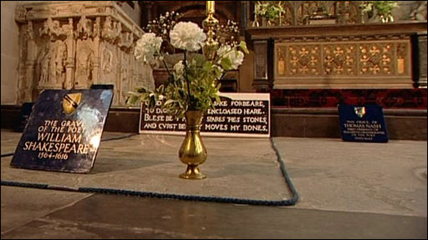
Shakespeare’s grave

Slide 13
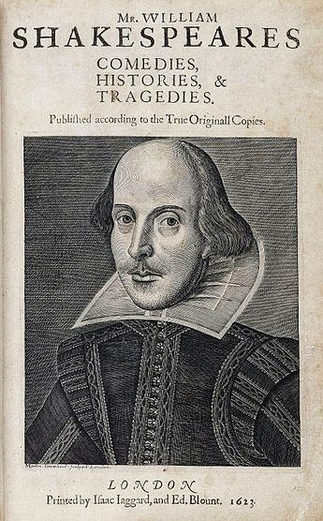
His wife Anna died 7 years later
That year everybody could see his works
Cover of his book

Slide 14
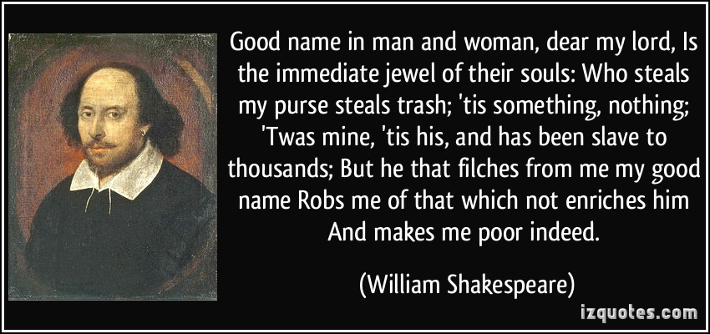
Shakespeare’s phrase

Slide 15
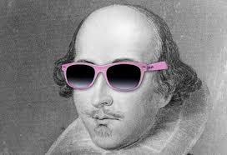
And that’s it! ☺ We hope that you enjoyed

