Slide 1
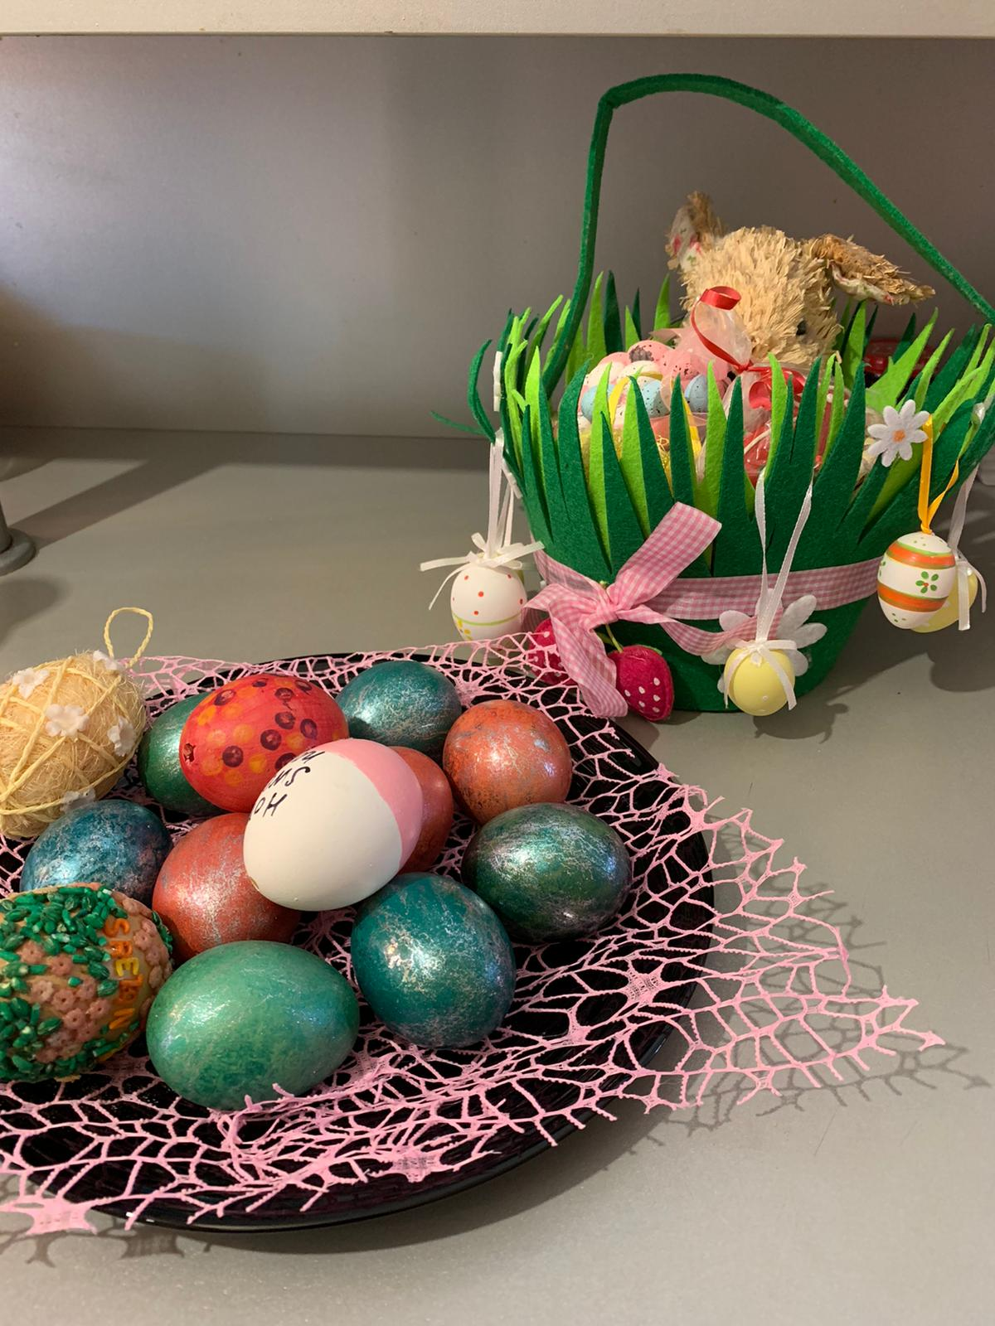
Easter traditions in Sveti Ivan Zelina

Slide 2
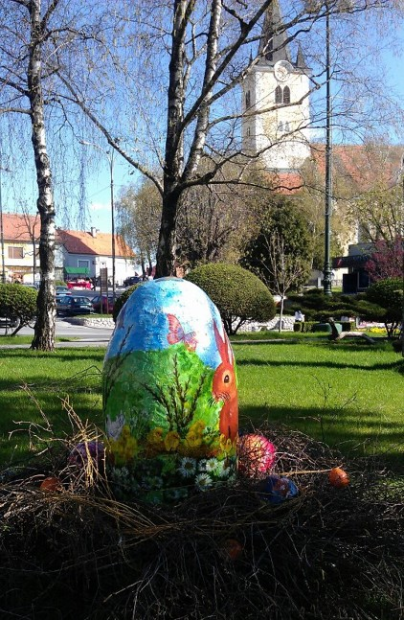
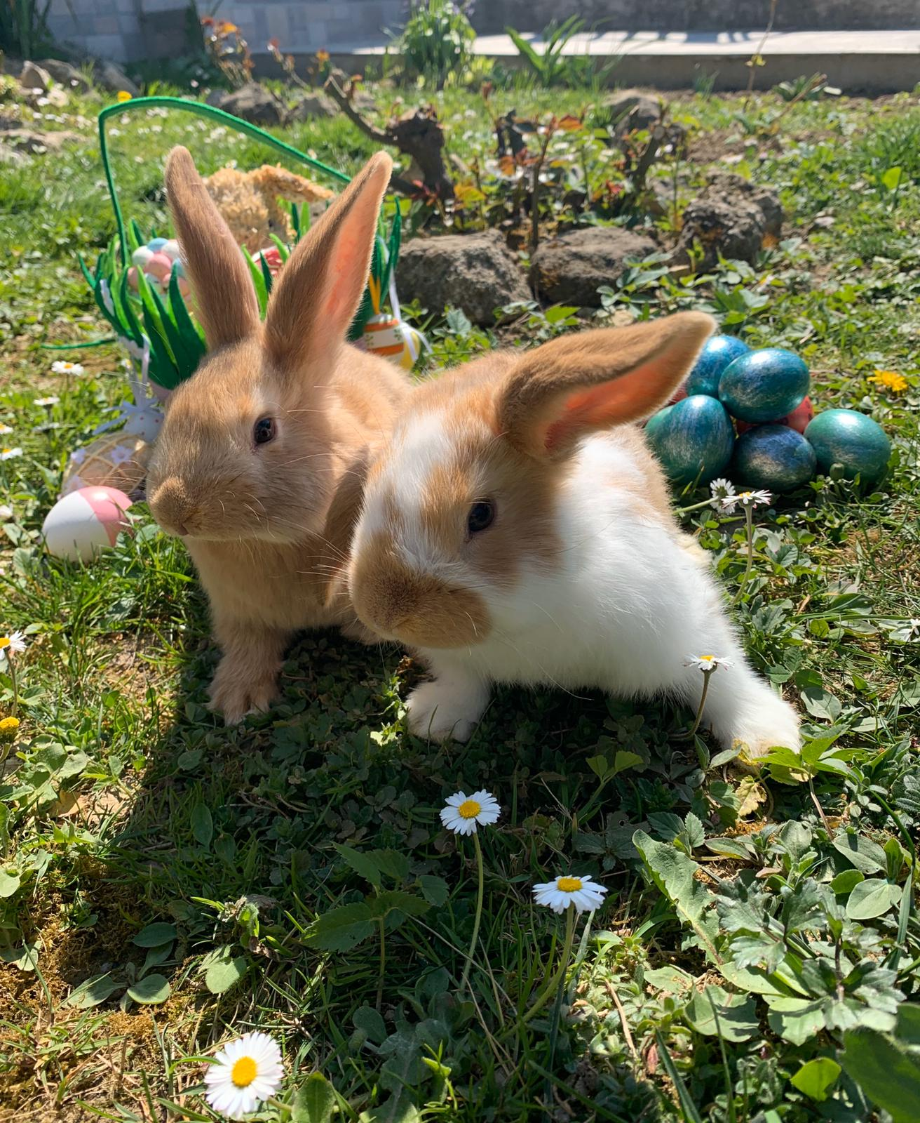
Hello! My name is Matija and I’ll tell you how we celebrate Easter in my family and my town…
For the last couple of years a lot of tourists visit Sveti Ivan Zelina during the Easter holidays
My town Sveti Ivan Zelina gets decorated with one big Easter egg in the middle of the main square
We also organize an Easter egg hunt on the main square

Slide 3
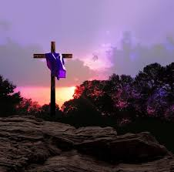
Lent
During Lent my family fasts every Friday
When the Lent starts,we set ourselves a goal to be better people and give up on something- I gave up on carbonated drinks
My whole family sticks to that tradition and all Christians should do the same.

Slide 4
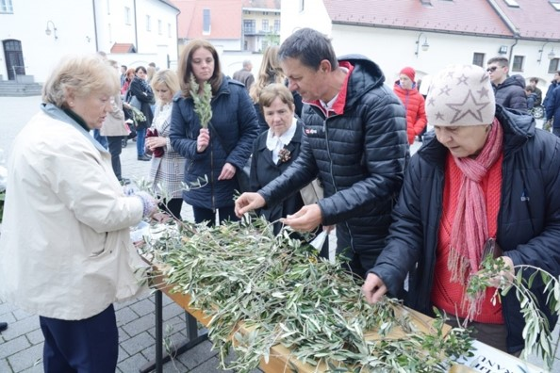
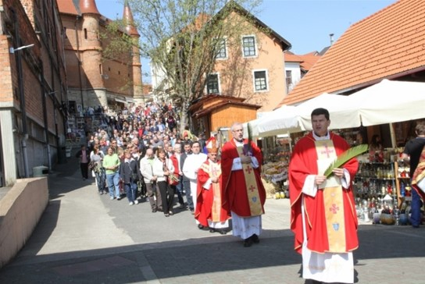
Palm Sunday
On Palm Sunday an olive branch is usually brought to Mass. We don’t have palms,so we bring cornelian cherry branches to Mass to be blessed instead
In front of the church we can buy olive branches which we also bring to be blessed
After Mass we bring the branches home where we keep them in a vase with other flowers
On Palm Sunday we sometimes visit Marija Bistrica, Croatia’s biggest Marian shrine,which is in a close vicinity to us (20 km)
There we take part in Mass and the procession

Slide 5
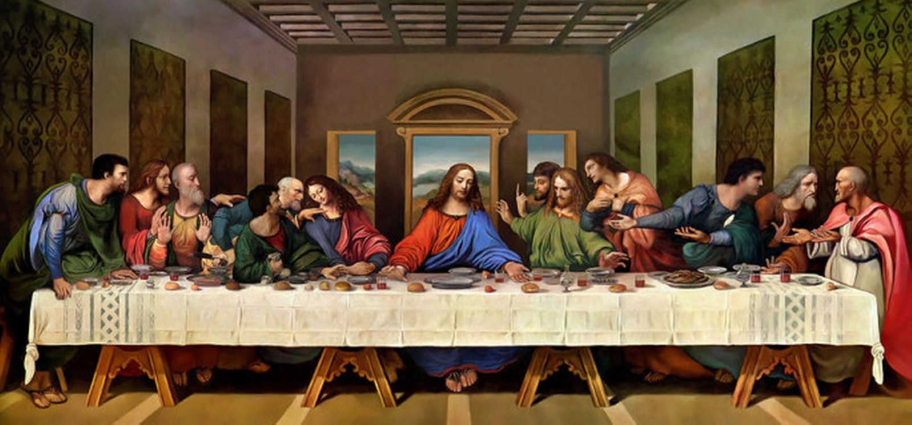
Holy Thursday
On Holy Thursday we go to the evening Mass, in memory of the Last Supper
School holidays start on Holy Friday and last the whole following week.
except for this year, when we don’t have holidays , on Tuesday we already came back to our virtual classrooms

Slide 6
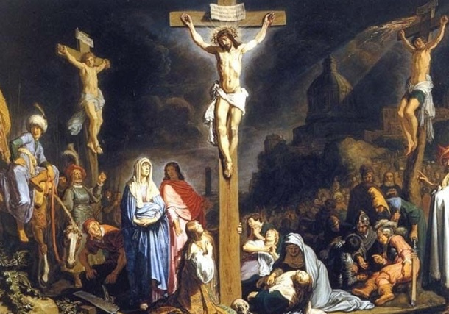
Holy Friday
On Holy Friday we fast – fish and potatoes are a must on the menu
Recipe: Firstly,we salt the fish. Then season it with garlic,parsley,Vegeta (mix of spices),olive oil and put in the oven for 30 minutes on 180 °C. We peel the potatoes and boil them in salted water for 30 minutes. After they’ve cooked,we drain and let them cool down. In the end we season them with onions,oil and vinegar.
We go to Mass

Slide 7
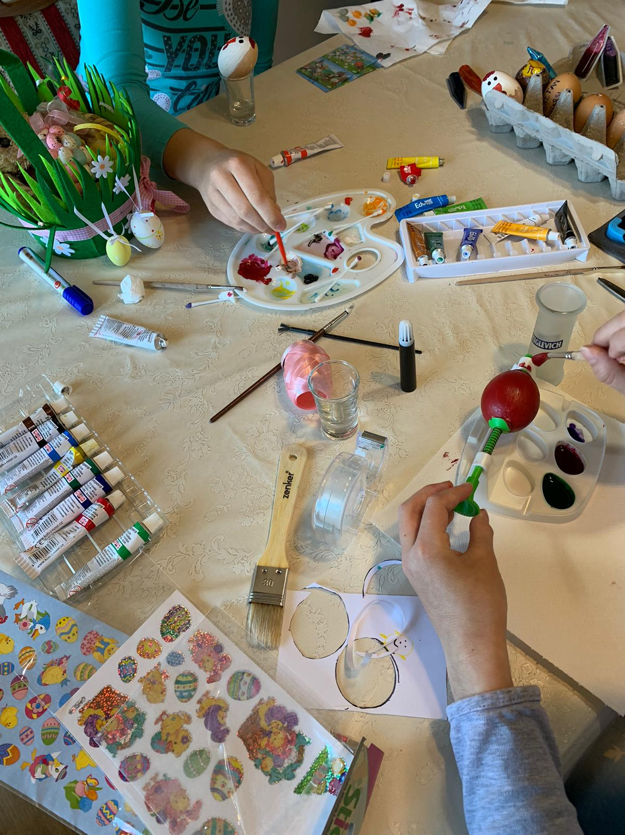
Holy Saturday
It’s a day of silence and prayer
We paint eggs which we call „pisanice”
Prepare food we’ll eat the next day
Bake all kinds of cakes
Collect wood for the bonfire we’ll light up on Sunday morning
You have to buy everything on time: stickers,chocolate bunnies and eggs,paint for the eggs…you’ll be left without it otherwise

Slide 8
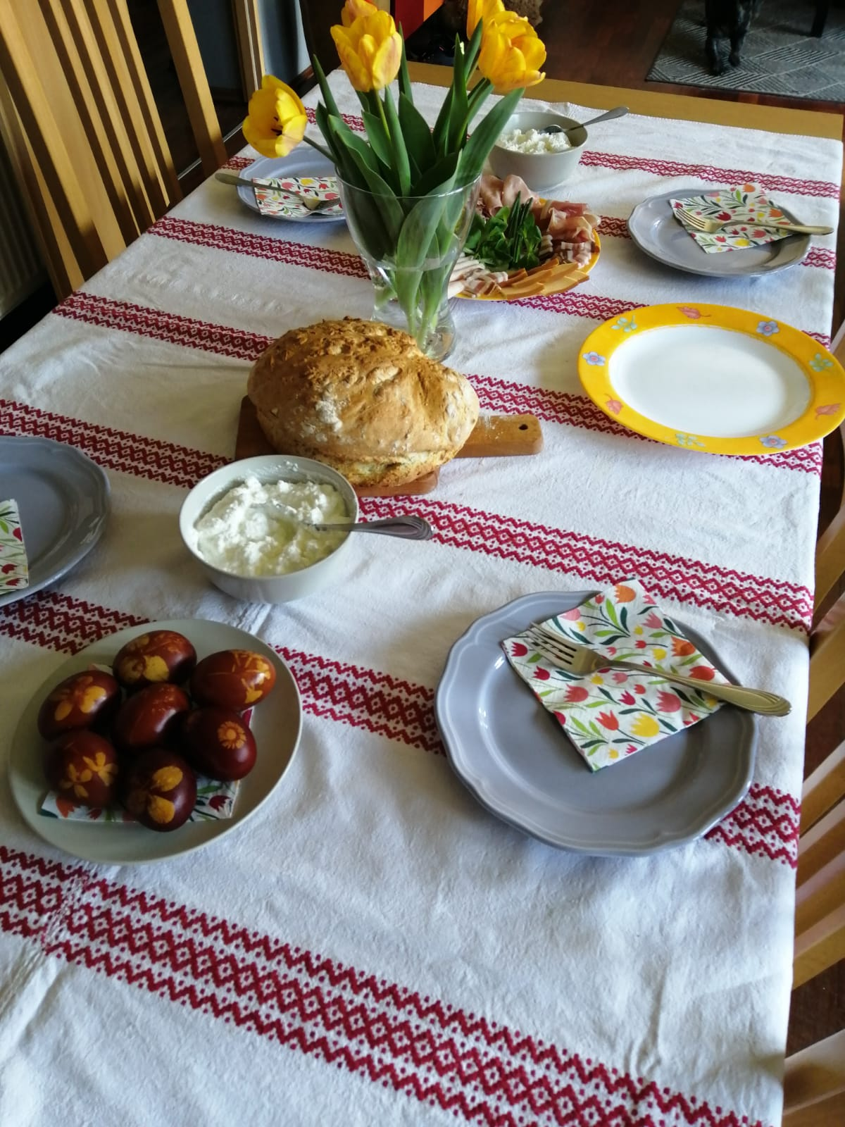
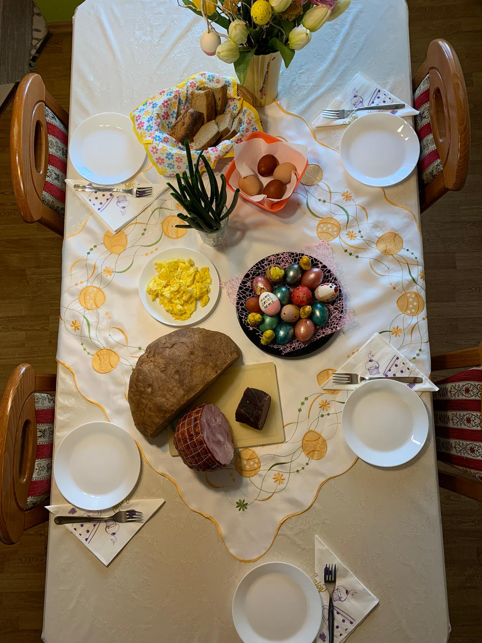
Easter
My mom bakes homemade bread
We go to Mass in the morning and bring food to be blessed
For breakfast we eat boiled eggs, roast pork, cooked ham, horseradish, radish, green onions, homemade bread…

Slide 9
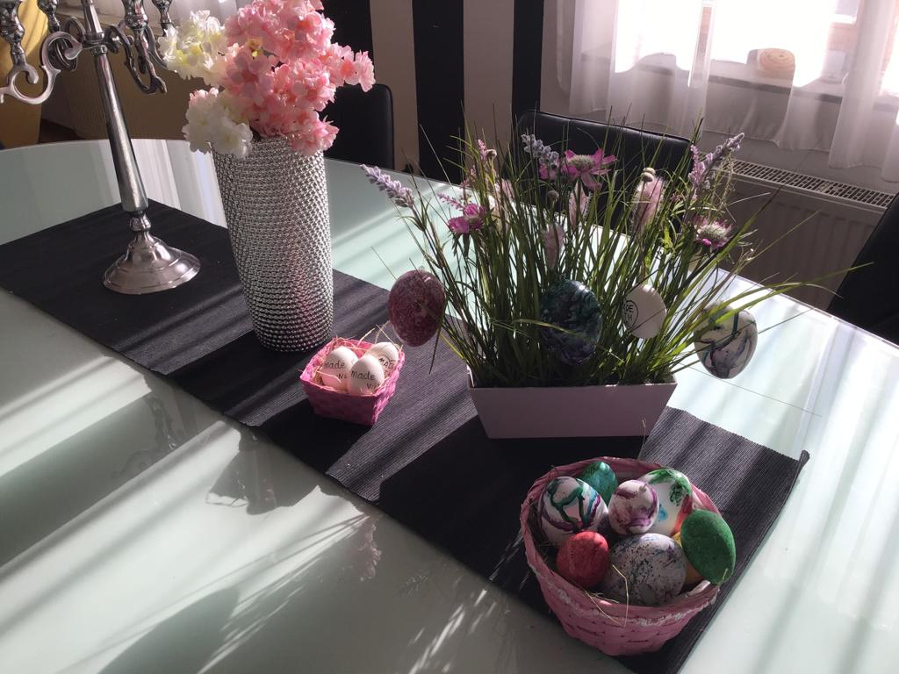
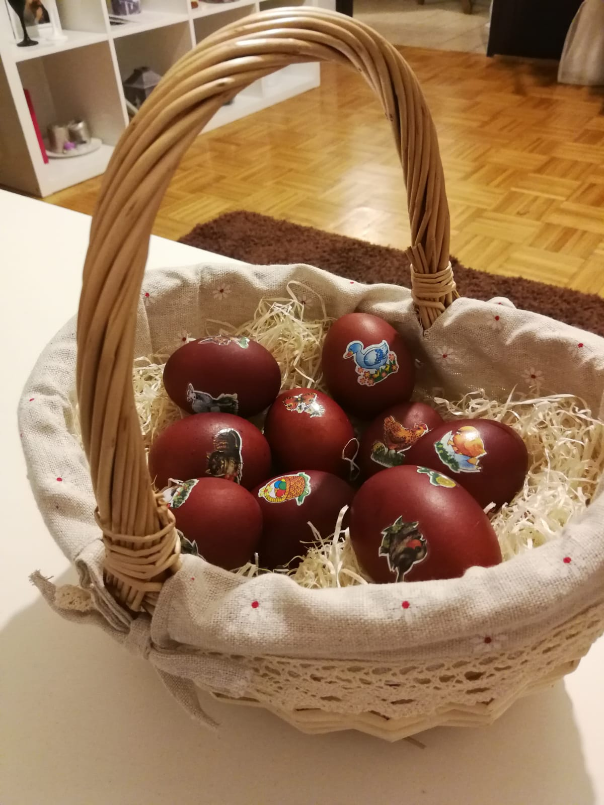
Easter Monday
Like in many other countries, in Croatia Easter Monday is also a national holiday
Everything is neatly decorated and solemn
My family still nourishes the tradition of going to our relatives to celebrate or vice versa. We also visit our neighbours.
Not a lot of people still go to each other’s houses to celebrate Easter, but they wish each other happy Easter by phone
We go to Mass

Slide 10
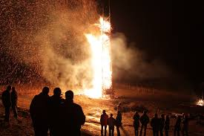
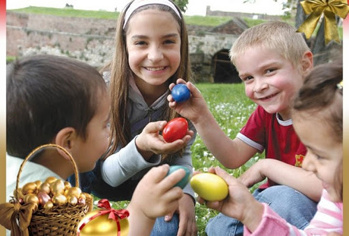
Some other Easter traditions…
In the game of „Tuckanje” you pick yourself an egg. Then you find an opponent with whom you will fight. You hit the two eggs against each other and whose egg remains intact wins. It’s a fun time for everyone,especially the kids.
People that have a holiday home go there to light a bonfire

Slide 11
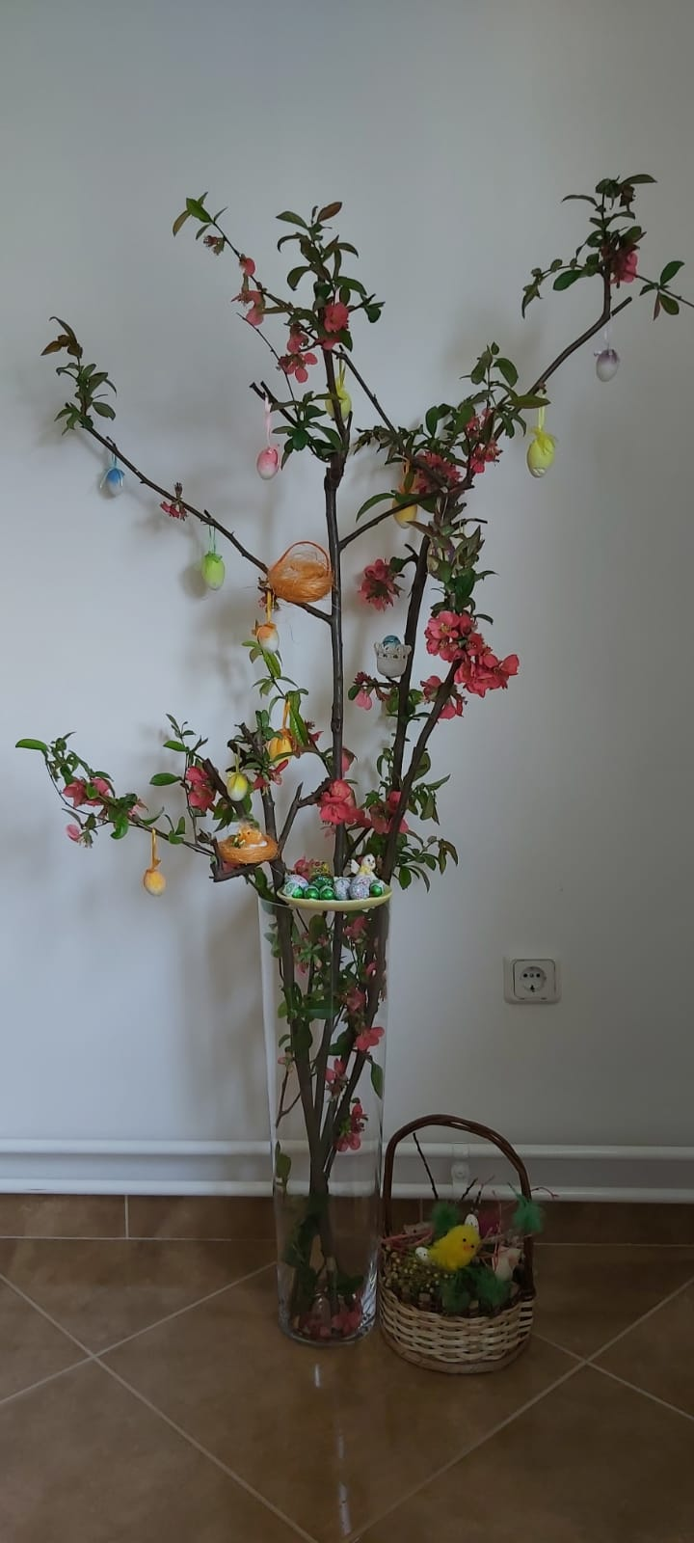
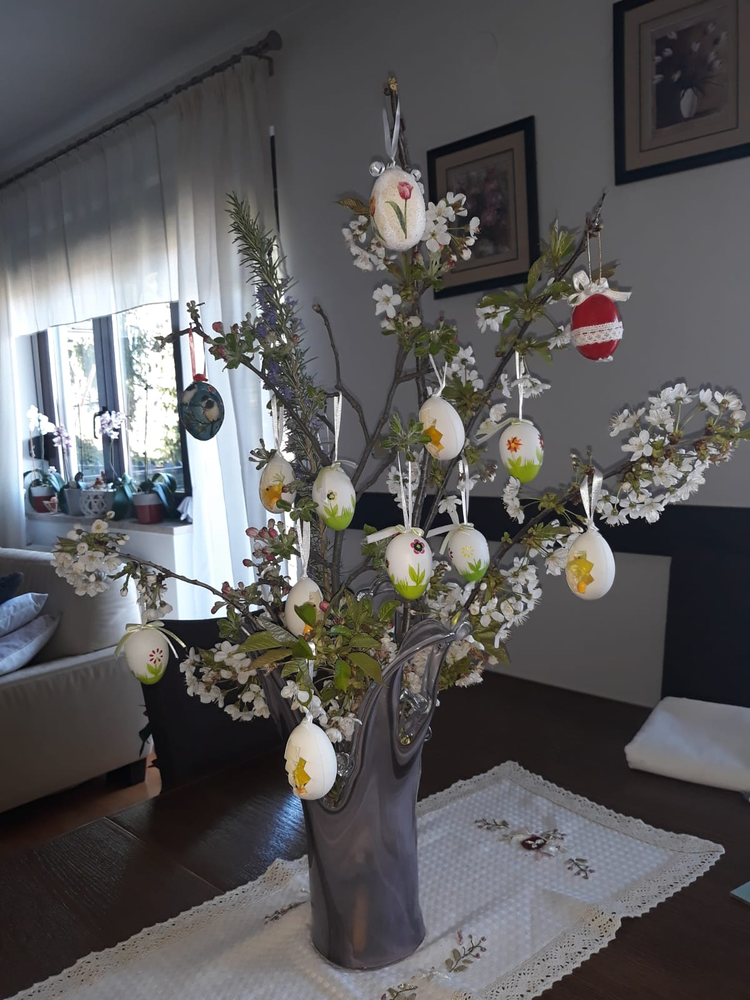
Some of our house decorations

Slide 12
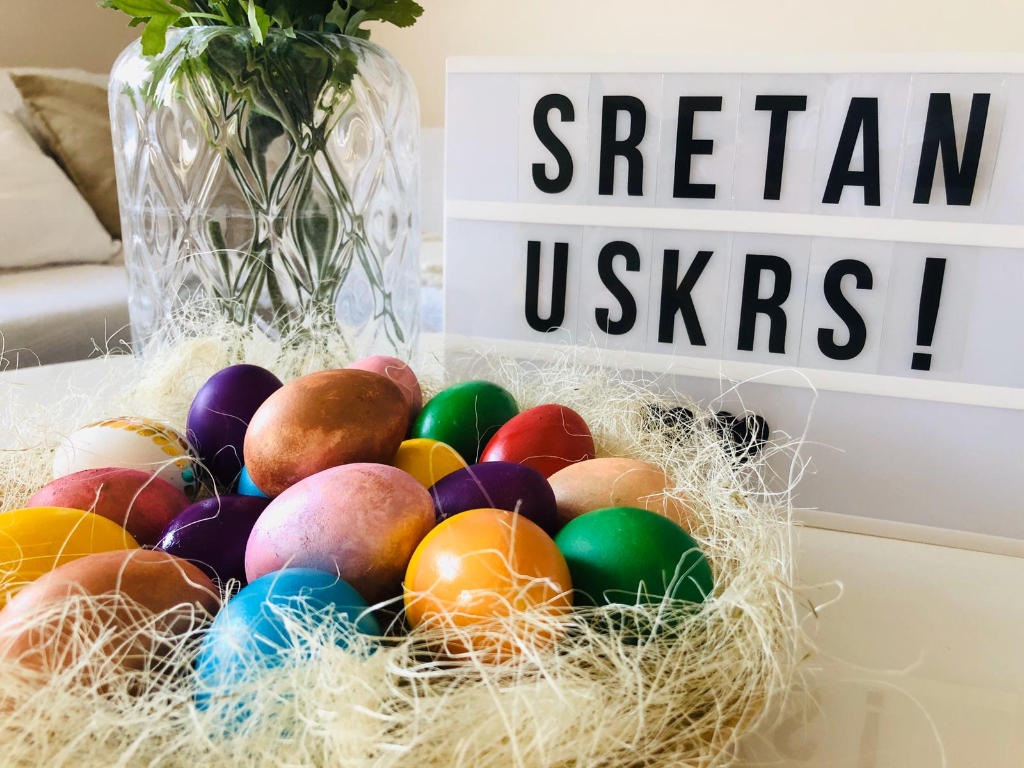
The end
Made by :
matija miklečić 8.d

